Slide 1

DEPARTMENT OF COMPUTER SCIENCE & ENGINEERING
SCHOOL OF COMPUTING
1156CS701- MAJOR PROJECT
INTERNSHIP THROUGH DIND
ENCORA PVT.LTD
WINTER SEMESTER(2023-2024)
REVIEW - I
“CYBER HACKING BREACHES PREDCTION USING
MACHINE LEARNING”
SUPERVISED BY
DR .P.J. BESLIN PAJILA
PRESENTED BY
1. NALLURI KARTHIK (VTU15337)(20UECS0659)
2. KOTA MANISH (VTU17731)(20UECS0501)
1

Slide 2
AGENDA
ABSTRACT
OBJECTIVE
INTRODUCTION
LITERATURE REVIEW
DESIGN AND METHODOLOGIES
IMPLEMENTATION
CONCLUSION
OFFER LETTER SOFT COPY/SCANNED COPY
INDUSTRY DETAILS
REFERENCES

Slide 3
ABSTRACT
Cyber-physical systems (cps) have made significant progress in many dynamic applications due to the integration between physical processes, computational resources, and communication capabilities. However, cyber-attacks are a major threat to these systems. Unlike faults that occurs by accidents cyber-physical systems, cyber-attacks occur intelligently and stealthy. Some of these attacks which are called deception attacks, inject false data from sensors or controllers, and also by compromising with some cyber components, corrupt data, or enter misinformation into the system. If the system is unaware of the existence of these attacks, it won’t be able to detect them, and performance may be disrupted or disabled altogether. Therefore, it is necessary to adapt algorithms to identify these types of attacks in these systems. It should be noted that the data generated in these systems is produced in very large number, with so much variety, and high speed, so it is important to use machine learning algorithms to facilitate the analysis and evaluation of data and to identify hidden patterns. In this research, the CPS is modeled as a network of agents that move in union with each other, and one agent is considered as a leader, and the other agents are commanded by the leader.

Slide 4
OBJECTIVES
Aim of the Project:
Cyber hacking breaches are driven by various motivations, including financial gain, cyber espionage, hacktivism, and personal curiosity. Criminals seek profit through data theft and fraud, while state actors engage in espionage. Hacktivists pursue political or social causes, and some hackers explore vulnerabilities for personal notoriety, highlighting diverse threats in cybersecurity.
Scope of the Project:
The project scope encompasses assessing existing cybersecurity measures, identifying vulnerabilities, implementing security enhancements, conducting user awareness training, and establishing continuous monitoring protocols. It aims to fortify digital systems and data protection against cyber hacking breaches.

Slide 5
INTRODUCTION
Recent advances in technology have led to the introduction of cyber-physical systems, which due to their better computational and communicational ability and integration between physical and cyber-components, has led to significant advances in many dynamic applications. But this improvement comes at the cost of being vulnerable to cyber-attacks. Cyber-physical systems are made up of logical elements and embedded computers, which communicate with communication channels such as the Internet of Things(IoT). More specifically, these systems include digital or cyber components, analog components, physical devices and humans that designed to operate between physical and cyber parts. In other words, a cyber-physical system is any system that includes cyber and physical components and humans, and has the ability to trade between the physical and cyber parts. In cyber-physical systems, the security of these types of systems becomes more important due to the addition of the physical part. Physical components including sensors, which receive data from the physical environment, maybe attacked and be injected incorrect data into the system. One of the most important challenges of a cyber-physical system, in its physical part is the presence of a large number of sensors in the environment, which collect so much data, with so much variety, and at high speed.

Slide 6
LITERATURE REVIEW
S. No | Journal Type with year | Authors | Title | Outcomes
1. | Journal, 2013 | Kwon, Cheolhyeon, Weiyi Liu, and Inseok Hwang | Security analysis for cyber-physical systems against stealthy deception attacks | The security issue in the state estimation problem is investigated for a networked control system (NCS). The communication channels between the sensors and the remote estimator in the NCS are vulnerable to attacks from malicious adversaries.
2. | Journal, 2017 | Pajic, Miroslav, James Weimer, Nicola Bezzo, Oleg Sokolsky, George J. Pappas, and Insup Lee. | Design and implementation of attack-resilient cyberphysical systems: With a focus on attack-resilient state estimators | Recent years have witnessed a significant increase in the number of security-related incidents in control systems. These include high-profile attacks in a wide range of application domains.

Slide 7
LITERATURE REVIEW
S.No | Journal Type with year | Authors | Title | Outcomes
3. | Journal, 2012 | Sheng, Long, Ya-Jun Pan, and Xiang Gong | Consensus formation control for a class of networked multiple mobile robot systems. | Embedded computational resources in autonomous robotic vehicles are becoming more abundant and have enabled improved operational effectiveness of cooperative robotic systems in civilian and military applications
4. | Journal, 2014 | Zeng, Wente, and Mo-Yuen Chow | Resilient distributed control in the presence of misbehaving agents in networked control systems | In this paper, we study the problem of reaching a consensus among all the agents in the networked control systems (NCS) in the presence of misbehaving agents

Slide 8
DESIGN AND METHOLOGIES
MODULE 1: USER
MODULE 2: SYSTEM

Slide 9
MODULE:1 -USER
1.1 Register:Users can register for the Cyber hacking breaches prediction using machine learning application here.
1.2 Login:After registering, the user can access his portal.
1.3 View Home page:Here user view the home page of the Cyber hacking breaches prediction using machine learning web application.
1.4 View about page:In the about page, users can learn more about the poverty classification.
1.5 Input Model:The user must provide input values for the certain fields in order to get results.
1.6 View Results:User view’s the generated results from the model.
1.7 View score:Here user have ability to view the score in %

Slide 10
MODULE:2 -SYSTEM
2.1 Working on dataset:System checks for data whether it is available or not and load the data in csv files.
2.2 Pre-processing:Data need to be pre-processed according the models it helps to increase the accuracy of the model and better information about the data.
2.3 Training the data:After pre-processing the data will split into two parts as train and test data before training with the given algorithms.
2.4 Model Building:To create a model that predicts the personality with better accuracy, this module will help user.
2.5 Generated Score:Here user view the score in %
2.7 Generate Results:We train the machine learning algorithm and predict the cyber-attack detection.

Slide 11
IMPLEMENTATION
1. Take the Dataset: The system accepts and processes the dataset provided by the user. This
dataset forms the foundation for building the predictive model.
2. Preprocessing: Before training a predictive model, the system preprocesses the dataset. This
includes handling missing data, data cleaning, and feature extraction. Preprocessing ensures that
the data is in a suitable format for modeling.
3. Training: The system uses machine learning techniques and Python modules to train a model
based on the preprocessed dataset. The model learns patterns and relationships within the data,
allowing it to make predictions.
4. Generate Results: Once the model is trained, the system can generate results based on user
input values. These results typically indicate whether the input data corresponds to a specific
condition, event, or prediction, such as Medical Insurance Cost

Slide 12
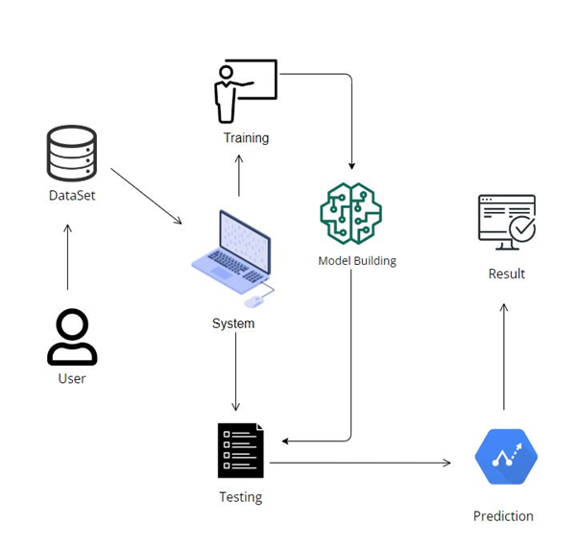
ARCHITECTURE DIAGRAM

Slide 13
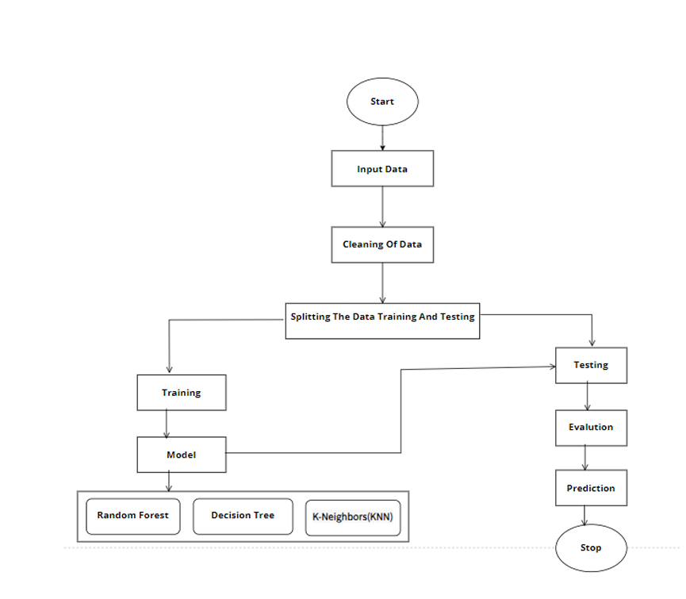
DATA FLOW DIAGRAM

Slide 14
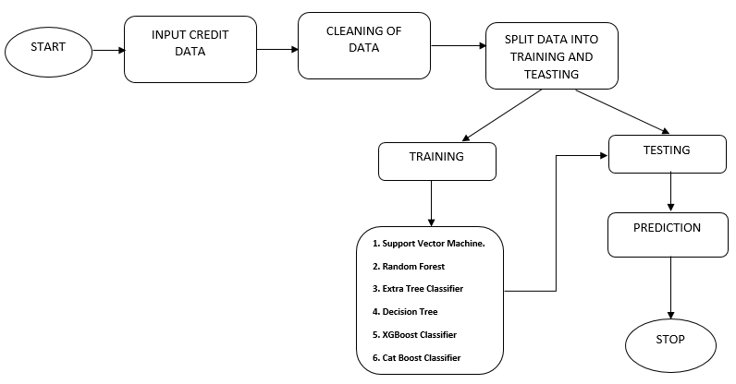
ER- DIAGRAM

Slide 15
CONCLUSION
We analyzed a hacking breach dataset from the incident inter arraival time and the breach size, and showed that they both should be modeled by stochastic process rather than distribution because they exhibit autocorrelations.here we are using a ARMA GARCH process for the evaluation of breaching incidents.we used support vector machine algorithm for classification purpose.we conducted both qualitative and quantitative analysis to draw further insights. The earlier the breach is detected, we will either stop any damage to the data or prevent damaging data.

Slide 16
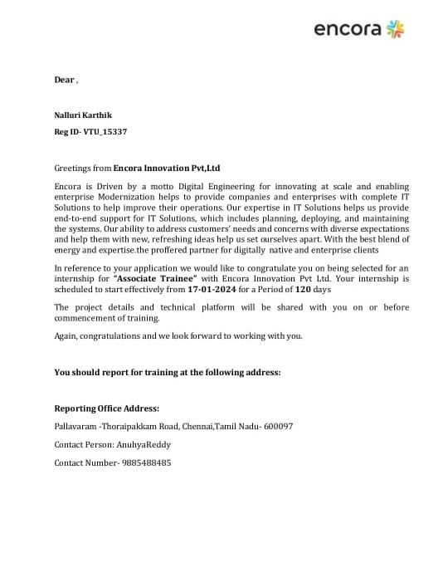
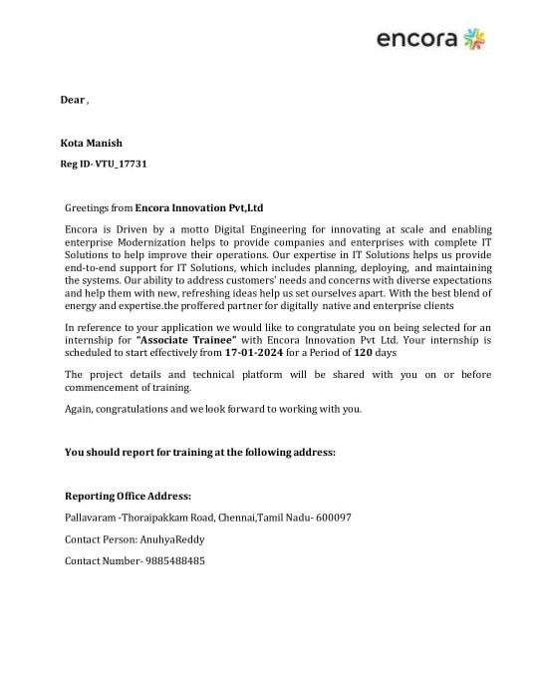
OFFER LETTER SOFT COPY/SCANNED COPY

Slide 17
INDUSTRY DETAILS
Industry Guide Name : Anuhya Reddy
Industry Mobile Number : 9885488485
Industry Guide Mail ID : encoraanuhya@gmail.com
Industry Address : Pallavaram -Thoraipakkam Road, Chennai,Tamil Nadu- 600097
Time line/Duration given by Industry for completion of Project : 4 Months(Jan 17-May17)
Date of Reporting to Industry :Jan-17th-2024

Slide 18
REFERENCES
[1] Kwon, Cheolhyeon, Weiyi Liu, and Inseok Hwang. ”Security analysis for cyber-physical systems against stealthy deception attacks.” In 2013 American control conference, IEEE (2013): 3344-3349.
[2] Pajic, Miroslav, James Weimer, Nicola Bezzo, Oleg Sokolsky, George J. Pappas, and Insup Lee. ”Design and implementation of attack-resilient cyberphysical systems: With a focus on attack-resilient state estimators.” IEEE Control Systems Magazine 37, no. 2 (2017): 66-81.
[3] Sheng, Long, Ya-Jun Pan, and Xiang Gong. ”Consensus formation control for a class of networked multiple mobile robot systems.” Journal of Control Science and Engineering 2012 (2012).
[4] Zeng, Wente, and Mo-Yuen Chow. ”Resilient distributed control in the presence of misbehaving agents in networked control systems.” IEEE transactions on cybernetics 44, no. 11 (2014): 2038-2049.
[5] Sun, Hongtao, Chen Peng, Taicheng Yang, Hao Zhang, and Wangli He. ”Resilient control of networked control systems with stochastic denial of service attacks.” Neurocomputing 270 (2017): 170-177.

Slide 19
[6] Zhang, Haotian, and Shreyas Sundaram. ”Robustness of information diffusion algorithms to locally bounded adversaries.” In 2012 American Control Conference (ACC), IEEE (2012): 5855-5861.
[7] Ozay, Mete, Inaki Esnaola, Fatos Tunay Yarman Vural, Sanjeev R. Kulkarni, and H. Vincent Poor. ”Machine learning methods for attack detection in the smart grid.” IEEE transactions on neural networks and learning systems 27, no. 8 (2015): 1773-1786.
[8] Tianfield, Huaglory. ”Data mining based cyber-attack detection.” System simulation technology 13, no. 2 (2017): 90-104.
[9] Pasqualetti, Fabio, Florian Dorfler, and Francesco Bullo. ”Attack detection and ¨ identification in cyber-physical systems.” IEEE Transactions on Automatic Control 58, no. 11 (2013): 2715-2729.

Slide 20
THANK YOU

